Slide 1
Distributed Game Engine

Slide 2
Introduction
Summary
Difficulties
Technologies

Slide 3

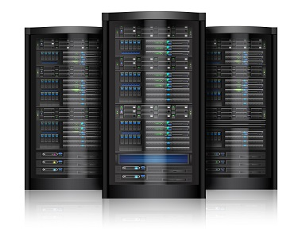

Summary
This project an attempt was made to build a distributed game engine that allows users to register on a UI service, authenticate with web tokens, queue up for practice and tournament plays, play against an opponent on real-time and keep track of user scores.
During this presentation we will explore various technologies and provide solutions to some of the problems that arose during the project development.

Slide 4
Technologies
Apache Zookeeper
Fault tolerance and high availability.
Apache Kafka / Kafka Streams
Reliable and distributed message passing on top of Zookeeper, interactive queries
Spring Boot
User authentication, DB management, RESTful API, STOMP, Kafka client, ...
Apache Maven and Java Modules
Building and maintain codebase
Docker / Docker Swarm
Deployment and scalability
Distributed MySQL stack (Nodes, Router, Failover)
Persistent storage and

Slide 5
Difficulties
User authentication and user data persistence.
Tournament creation and maintenance.
Score updates and retrieval.
Reliable and distributed message passing between server and clients.
Game and Play state management and consistency.
Deployment and scalability of Docker containers.
Java module structure and maven efficient dependency management.

Slide 6
Spring
Services and Dependencies
Authentication
JPA
RESTful API
Websockets - STOMP
Kafka Listener
Kafka Template

Slide 7
Spring Service and Dependency Architecture
Inversion of Control is a principle in software engineering by which the control of objects or portions of a program is transferred to a container or framework. It's most often used in the context of object-oriented programming.
By contrast with traditional programming, in which our custom code makes calls to a library, IoC enables a framework to take control of the flow of a program and make calls to our custom code. To enable this, frameworks use abstractions with additional behavior built in. If we want to add our own behavior, we need to extend the classes of the framework or plugin our own classes.
The advantages of this architecture are:
decoupling the execution of a task from its implementation
making it easier to switch between different implementations
greater modularity of a program
greater ease in testing a program by isolating a component or mocking its dependencies and allowing components to communicate through contracts
Inversion of Control can be achieved through various mechanisms such as: Strategy design pattern, Service Locator pattern, Factory pattern, and Dependency Injection (DI).

Slide 8
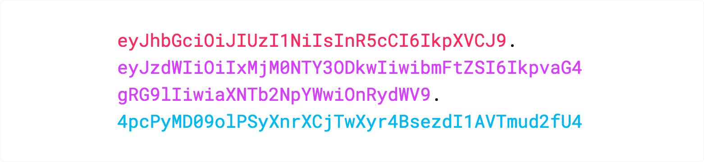
Authentication
JSON Web Tokens (JWTs) are an open, industry standard RFC 7519 method for representing claims securely between two parties.
JSON Web Tokens consist of three parts separated by dots ‘ . ’ , which are:
Header
Payload
Signature
The payload contains claims. Claims are statements about an entity (typically, the user) and additional metadata. Claims are used throughout this project in order to authenticate Users
and validate their Roles (eg. Official).

Slide 9
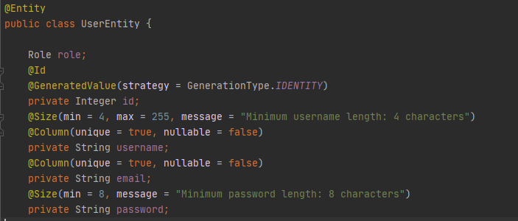
Spring JPA Repositories
Spring allows us to interact with various MySQL via a JPA Repository interface. We simply need to declare Entities which are Serializable objects that can be persisted on a variety of Databases, in our case a distributed MySQL stack. Repository interfaces allow us to query entities by using their field names.

Slide 10
RESTful API
The constraints of the REST architectural style affect the following architectural properties:
performance in component interactions, which can be the dominant factor in user-perceived performance and network efficiency;^{[9]}
scalability allowing the support of large numbers of components and interactions among components. Roy Fielding describes REST's effect on scalability.
simplicity of a uniform interface;
visibility of communication between components by service agents;
portability of components by moving program code with the data;
reliability in the resistance to failure at the system level in the presence of failures within components, connectors, or data

Slide 11
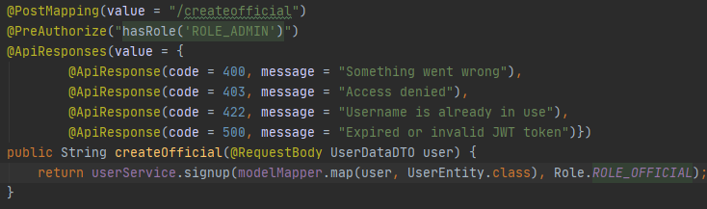
RESTful API (Example)
The method used by Admin clients in order to register Officials.
Spring @RestController Class that accepts a POST request only from authenticated Users with the role of ADMIN (derived by analyzing the JWT claims). The UserData contains the Official’s necessary information.
Request options and headers (eg. Authorization bearer token) can be accessed with various @Annotations on-demand. The function response is encapsulated in an HTTP entity and returned to User as a server response. Exception handling and predetermined responses on error codes can also be seamlessly defined.

Slide 12
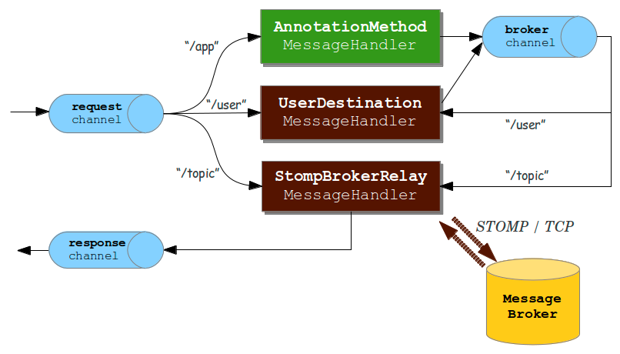
Websockets and STOMP
Reliable communication between authenticated users and server.
Messages can be sent arbitrarily, to topics and users based on provided headers.
STOMP assigns a unique session ID to each authenticated user, in our case it’s their username.
Spring allows the definition of SPRING controllers that behave like @RestControllers and essentially treat incoming and outgoing messages as POST requests.
STOMP is a quick and reliable way to send highly customized messages to a group of Users (eg. Players of a game).

Slide 13
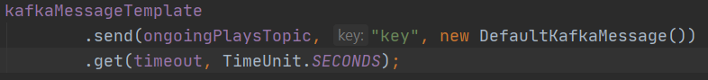
Kafka Template and Event Listener
Spring can interact with Kafka either via Messaging Template that ensures type safety or via an event listener. Both options can be greatly customized as both can be passed a Kafka factory reference (contain options that are used to build the clients and manage messages).

Slide 14
Apache Kafka
Fundamentals
Partitioning
Kafka Streams
State stores
Interactive Queries

Slide 15
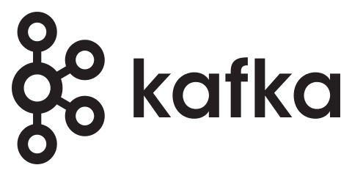
Apache Kafka
Apache Kafka is a distributed and fault-tolerant streaming platform with the following key capabilities.
Publish and subscribe to streams of records similar to a message queue.
Store streams of records in a fault-tolerant durable way.
Process streams of records as they occur.
Key terminology:
Kafka creates, maintains and processes data in the form of key-value pairs called records.
Kafka maintains streams of records by persisting them in topics.
Processes that publish messages to Kafka topics are called producers.
Processes that subscribe to one or more topics and process their streams are called consumers.
Topics consist of one or more partitions.
Brokers are servers of a Kafka cluster that hold a number of partitions.
Records contain fields that include metadata of the above information.
Kafka is generally used for building real-time and fault-tolerant applications and most specifically:
Data pipelines that reliably get data between systems or applications.
Streaming applications that transform or react to the streams of data.

Slide 16
Kafka Topics
Applications can read or write records in topics which is Kafka’s abstraction of storing data streams.
Key concepts of topics:
Multi-subscriber A topic can have zero, one, or many consumers that subscribe to the data written to it.
Consist of many partitions Each partition is an ordered, immutable sequence of records that is continually appended to. The records in the partitions are assigned a sequential id (offset) that uniquely identifies each record within the partition. They allow topics to scale beyond the size of a single server.
Retention period The Kafka cluster durably persists all published records—whether or not they have been consumed—using a configurable retention period.
Meta-data The only metadata retained on a per-consumer basis is the offset of that consumer in the partition.

Slide 17
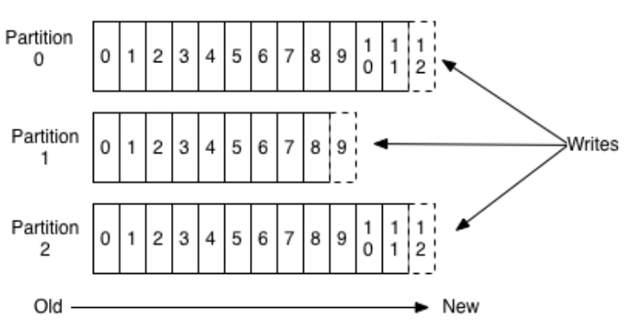
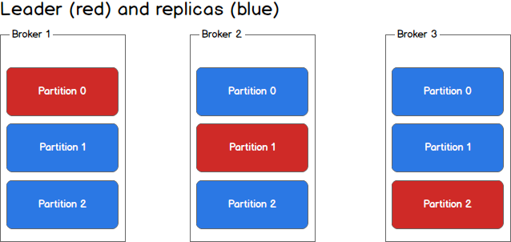
Distribution
The partitions of a topic are distributed over a number of brokers with each one handling data and requests for a share of the partitions. Each partition is replicated across a configurable number of brokers for fault tolerance.
Each partition has one server which acts as the leader and zero or more servers which act as followers. The leader handles all read and write requests for the partition while the followers passively replicate the leader. If the leader fails, one of the followers will automatically become the new leader.
Anatomy of a Kafka Topic
Brokers with topics

Slide 18
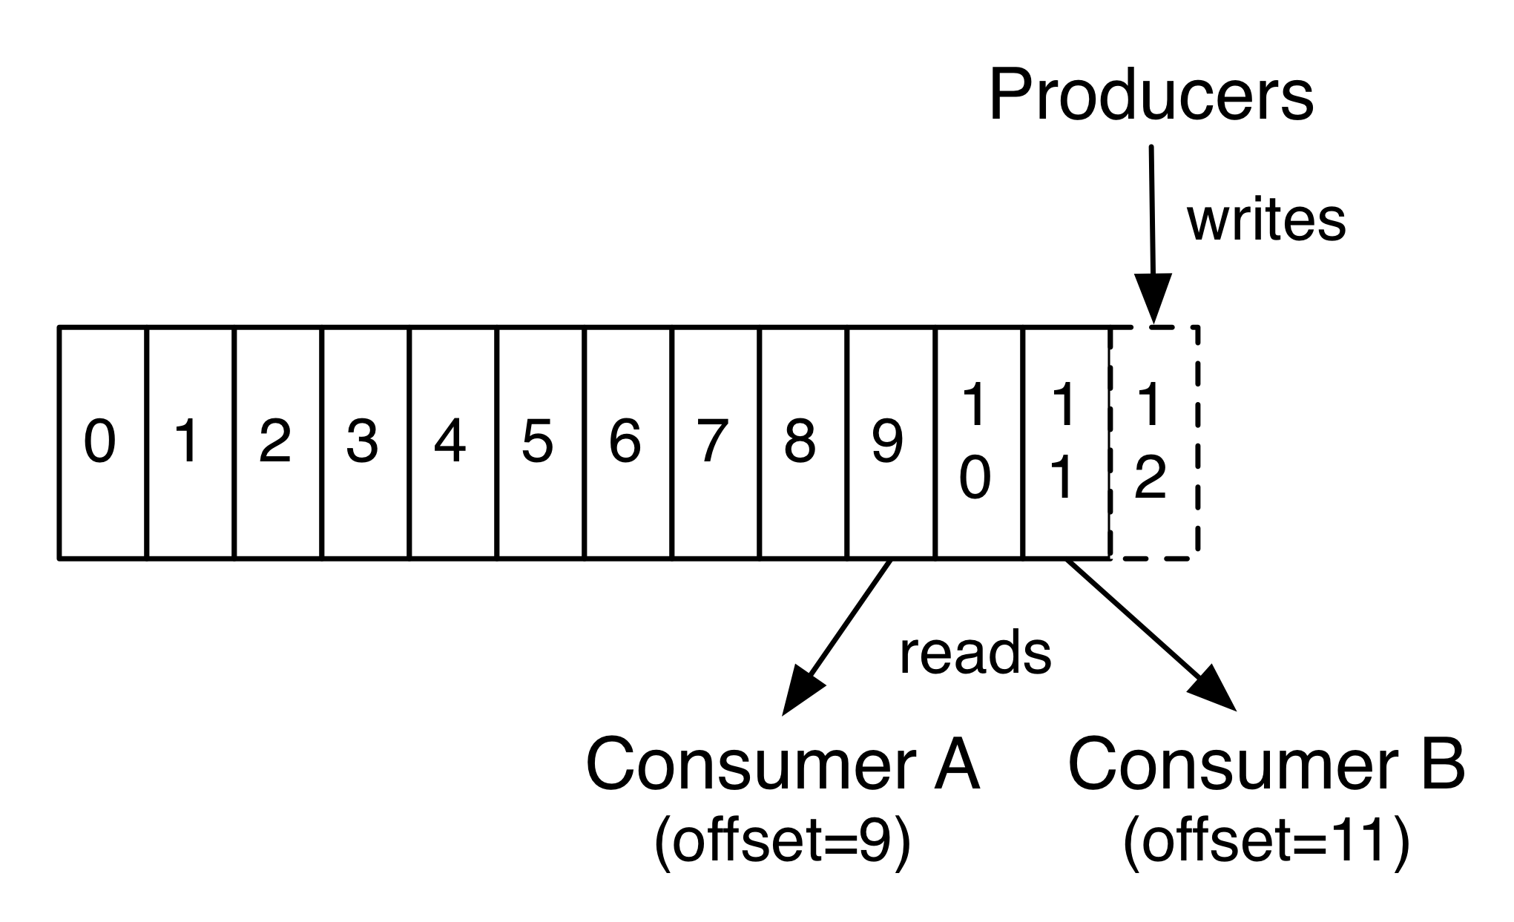
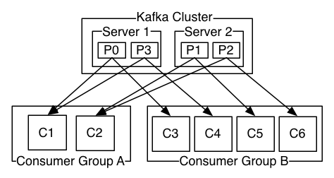
Producers and Consumers
Producers publish records to specific partitions of topics. Assignment can be done in a round-robin fashion to balance load or according to some semantic partition function (eg. key hash).
Consumers label themselves with a consumer group name and each record published to a topic is delivered to one consumer instance within each subscribing consumer group. Multiple consumer instances within the same group receive records in a round-robin manner. However, if all the consumer instances have different consumer groups then each record will be broadcast.
Producer and consumer on a single topic
Producer with multiple consumer groups

Slide 19
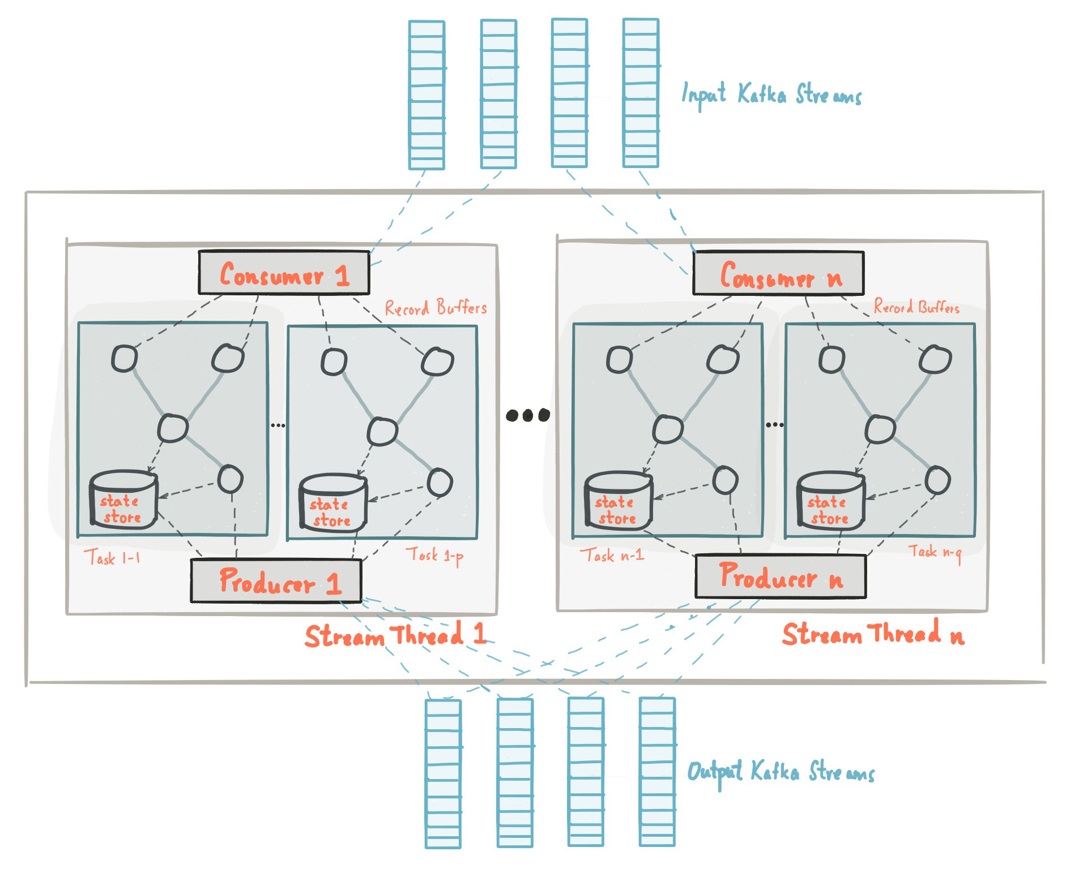
Kafka Streams
Kafka Streams simplifies application development by building on the Kafka producer and consumer APIs and leveraging the native capabilities of Kafka to offer data parallelism, distributed coordination, fault tolerance, and operational simplicity.
Key concepts:
Application topologies stream records from a Kafka topic and flush them to a Kafka sink.
Between producer and consumer instances a number of transformations can be applied to incoming data streams.
Parallelism model is based on partitions.
State stores allow for fast access to data summaries.
Fault tolerance provided by the Kafka cluster is extended in order to make state stores durable.

Slide 20
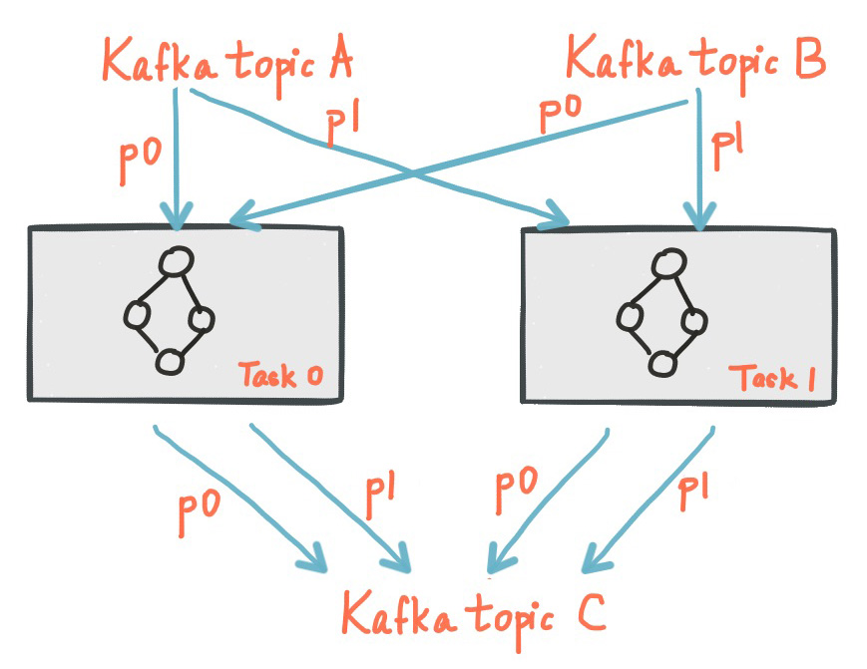
Kafka Streams partitions and tasks
Kafka Streams partitions data for processing it which enables data locality, elasticity, scalability and fault tolerance. Kafka Streams uses the concepts of partitions and tasks as logical units of its parallelism model based on Kafka topic partitions.
Each stream partition is a totally ordered sequence of data records and maps to a Kafka topic partition.
A data record in the stream maps to a Kafka message from that topic.
The keys of data records determine how data is routed to specific partitions within topics.
Kafka Streams creates a fixed number of tasks based on the input stream partitions of the application, with each task assigned a list of partitions from Kafka topics.
The assignment of partitions to tasks never changes and if an application instance fails all of its tasks will be automatically rebalanced.
The diagram above shows two different topics consumed by two tasks..

Slide 21
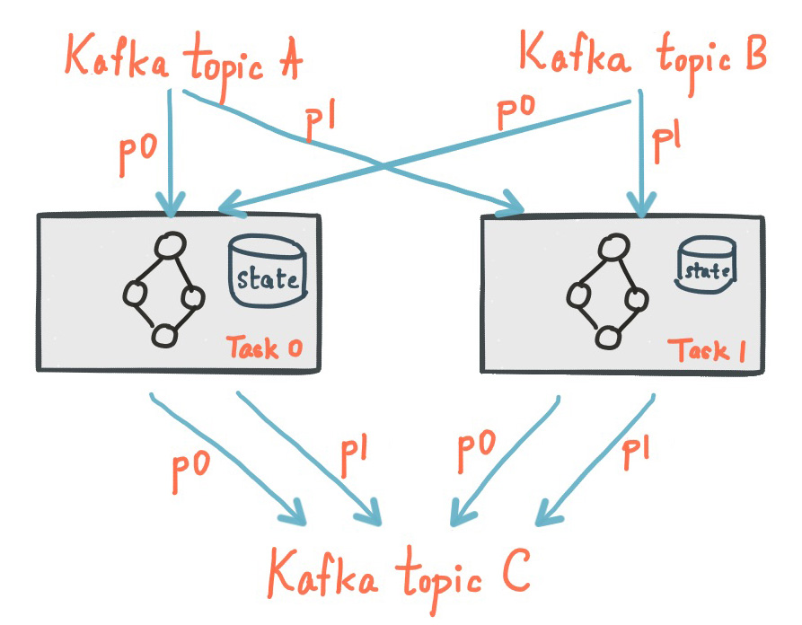
State stores
Kafka Streams provides state stores which can be used to store and query data. The Kafka Streams DSL automatically manages such state stores when you stateful operators are called.
Useful info about state stores.
Every stream task in a Kafka Streams application may embed one or more local state stores that can be accessed via APIs to store and query data (aka Interactive Querying).
State is created and cleaned up automatically.
All application instances are aware of other application instances and their locations (ip:port).
Kafka Streams offers fault-tolerance and automatic recovery for such local state stores.
State stores are located in Kafka changelog topics that have log compaction enabled.
The diagram shows two stream tasks with their dedicated local state stores.

Slide 22
Docker Swarm
Introduction
Docker Registry
Swarm configuration
Swarm deployment
Deployment configurations

Slide 23

Introduction
Docker provides the ability to package and run an application in a loosely isolated environment called a container.
Docker provides tooling and a platform to manage the lifecycle of your containers:
Develop your application and its supporting components using containers.
The container becomes the unit for distributing and testing your application.
When you’re ready, deploy your application into your production environment, as a container or an orchestrated service.

Slide 24
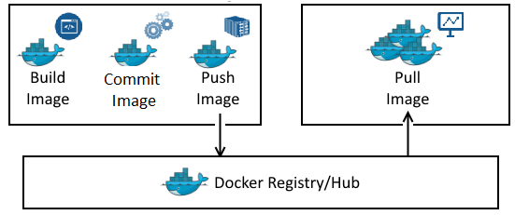
Docker Registry
The Registry is a stateless, highly scalable server side application that stores and lets you distribute Docker images.
Registry should be used if we want to:
Tightly control where your images are being stored.
Fully own your images distribution pipeline.
Integrate image storage and distribution tightly into your in-house development workflow.

Slide 25
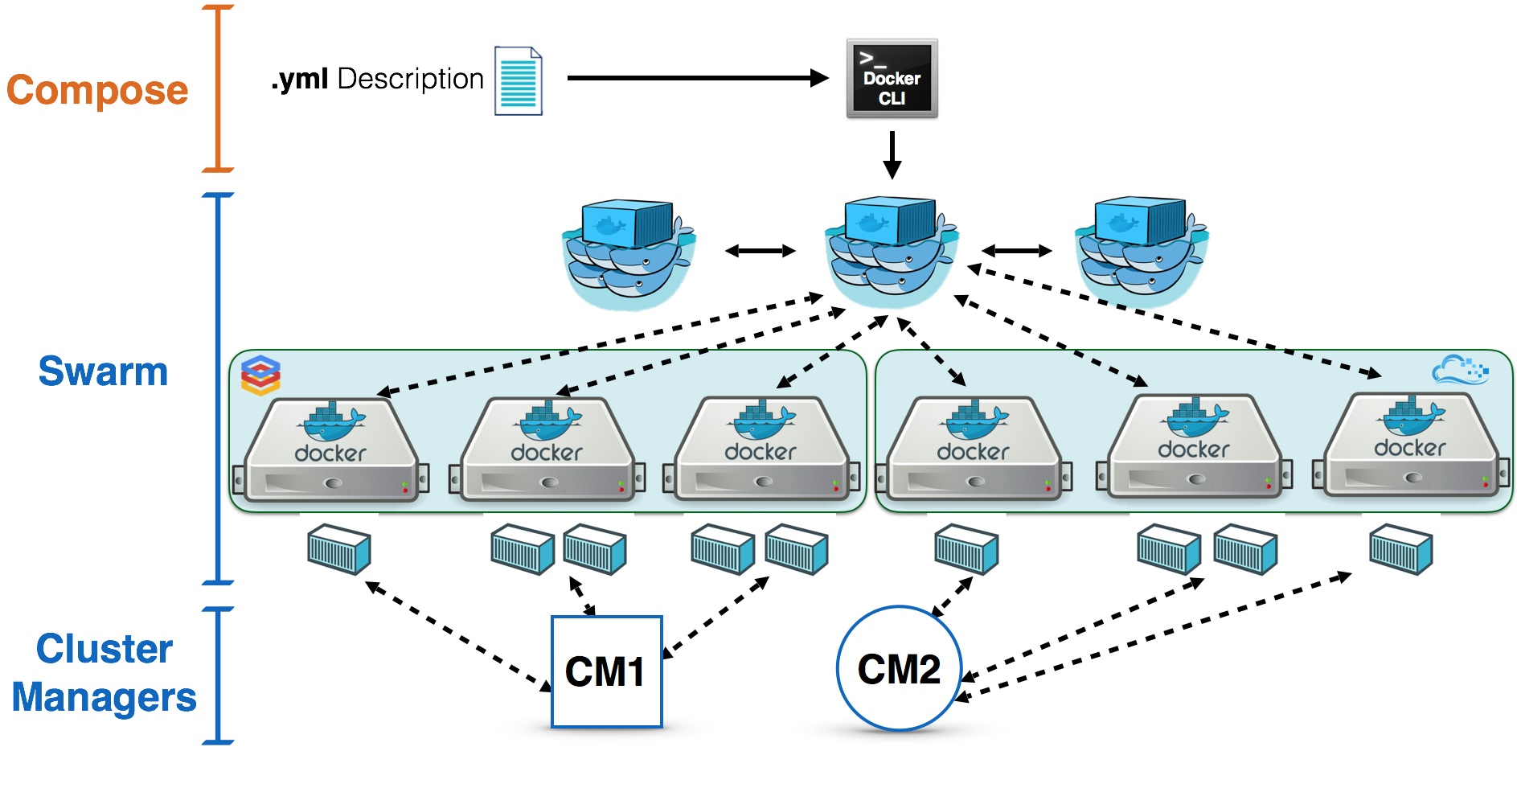
Swarm configuration
A Docker Swarm is a group of either physical or virtual machines that are running the Docker application and that have been configured to join together in a cluster.
Docker swarm is a container orchestration tool, meaning that it allows the user to manage multiple containers deployed across multiple host machines.
Containers can be described in a markup language file (usually called swarm.yml) and user, program, cluster and container options can easily be configured.

Slide 26
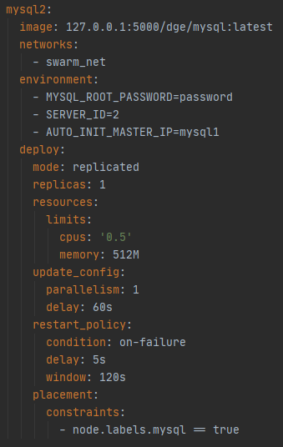
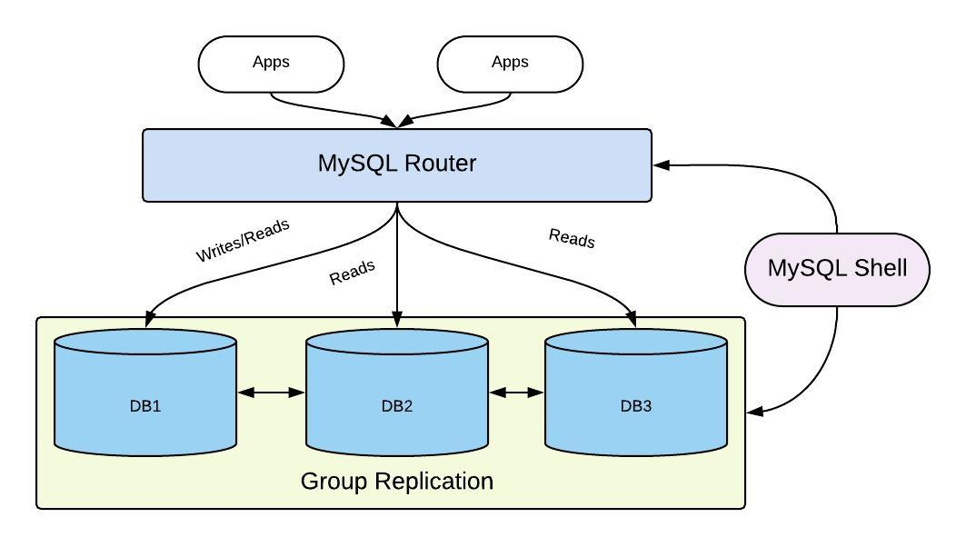
Swarm deployment - MySQL stack
Our deployment consists of 2 MySQL instances that contain User and Play data.
An efficient MySQL Routing container and a MySQL Failover service ensure high availability and reliability.

Slide 27
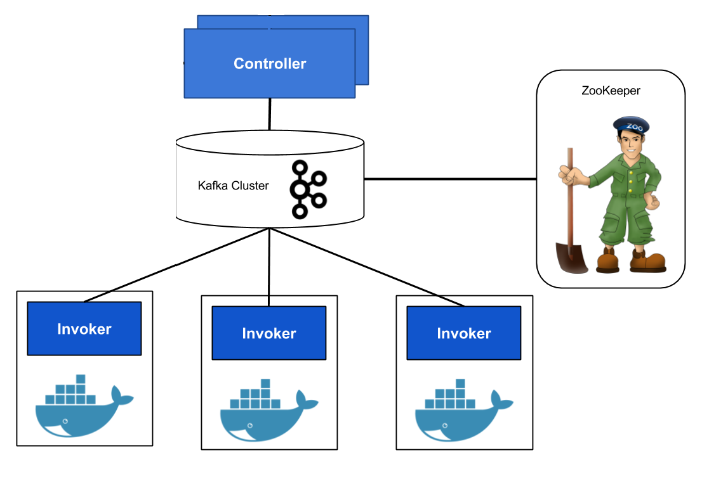
Swarm deployment - Kafka-Zookeeper stack
A Kafka cluster consists of:
Multiple Kafka Brokers that facilitate the message passing between clients.
At least once Zookeeper instance for fault-tolerance and state management.
A restart policy on each broker to minimize downtime.
Access to the swarm network in order to communicate with other swarm services.

Slide 28
Game Engine Architecture
Architecture Overview
Player - UI interaction
Kafka Stream Topologies
Game Client
Bringing the individual components together

Slide 29



Architecture Overview
All user requests go through the UI. If the User needs to access Game/Play Master service information then the UI will do it on their behalf and respond with the result.
Game and Moves
Player
Game Master Instances
Game Client
Moves and Score
UI Service
Play Master Instances
Play information

Slide 30
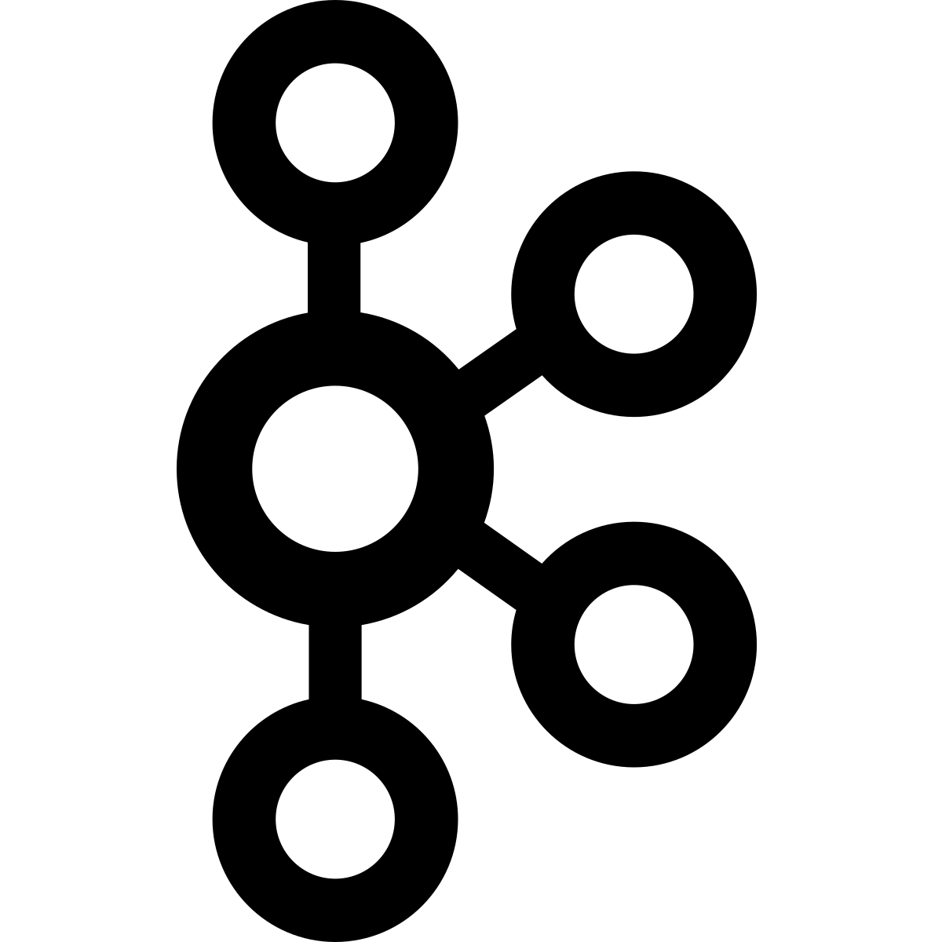
Player - UI Interaction
User credentials, moves and play information are constantly being exchanged with the UI service.
All user requests, no matter the target service, will go through a UI service instance.
In order to make decisions and join games the player needs to be provided with information such as:
An opponent to their preferred game type upon queuing up.
Current play information (eg. board state).
Opponent actions and validity of own moves.
Tournament results (Top 4 winner).
User Interface Instance
DB
Player
Game Client

Slide 31
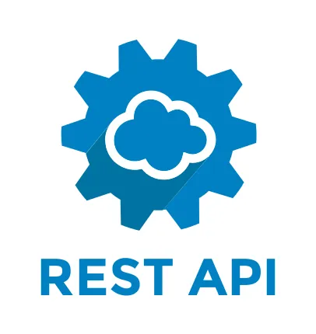
Kafka Game Master Topologies
The Game Master service is tasked with pairing “queue-up requests” from players and keeping consistent user scores based on the finished PM games. The requests can be either for practice plays, creating a tournament and joining a tournament.
Tournaments
Create / Join Tournaments
Play with ID=121
Play with ID=128
Play with ID=124
Player messages via UI
New Plays
Play with ID=123
Join Practice Plays
Practice
Plays Queue
Assign to PM based on key=PlayID
Play Master Instance #3
Play Master Instance #3
User Scores
Play Master Instance #3
Interactive Queries
Notes:
Users send a “Queue up” message to the UI and the UI is forwarding this message to the GM.
All Plays are the same Object. Some Plays
Interactive Queries are essentially an HTTP call to the PM service in order to retrieve a Kafka key.

Slide 32
Kafka Play Master Topologies
User Moves
User Scores
Completed Plays
Completed Plays
Left Join on PlayID
Check Validity
Update Play State
Unfinished Plays
Ongoing Plays
Ongoing Plays
Move Response to User
Notes:
Plays are consumed as a KTable, so records overwrite older records with same keys.

Slide 33
Questions?
Thank you for your time

